Slide 1
PRINCIPAL’S REPORT

Slide 2
TOPICS
School Start Update
Current Enrollment & Leveling
School Strategic Plan
Strategic Plan Overview
SMART Goals
GMAS Results

Slide 3
SCHOOL START
UPDATE

Slide 4
ENROLLMENT
Projected Enrollment | 391
Current Enrollment | 424
Difference | -33
LEVELING
Leveling is the process the District uses to adjust school budget allocations to match student enrollment.
Notes:
Principals: Based on your enrollment, please give your GO Team the information on how you plan to account for any budget changes due to leveling.
Change in enrollment was a decrease from 424 students to 391. A difference of 33 students.

Slide 5
LEVELING
Leveling | $(96,145)
General Fund Carryover | $12,452
School Reserve Funds | $69,162
Net Adjustment: | $(14,531)
Leveling is the process the District uses to adjust school budget allocations to match student enrollment.
Budget Impact | (Principal: input change in allocation for your school and discuss how you are going to address the change in allocation)

Slide 6
LEVELING
Position Changes
Add/Reduce | Position | FTE | Dollar Amount
Reduce | 5th Grade Teacher | 1.0 | $(92,616)
Leveling is the process the District uses to adjust school budget allocations to match student enrollment.
Budget Impact | (Principal: input change in allocation for your school and discuss how you are going to address the change in allocation)
Notes:
We lost one unit, however we did not lose any teachers. The vacant 5th grade position was used for leveling. Leveling did not impact teacher vacancies.

Slide 7
LEVELING
Teaching/Other Supplies | $78,085
Leveling is the process the District uses to adjust school budget allocations to match student enrollment.
Budget Impact | (Principal: input change in allocation for your school and discuss how you are going to address the change in allocation)
Notes:
Principals: Based on your enrollment, please give your GO Team the information on how you plan to account for any budget changes due to leveling.
Change in enrollment was a decrease from 424 students to 391. A difference of 33 students. We lost one unit, however we did not lose any teachers. The vacant 5th grade position was used for leveling. Leveling did not impact teacher vacancies.

Slide 8
STAFFING

Slide 9
MEDIA SPECIALIST
POSITION FILLED
MS. TANISHA JACKSON

Slide 10
ART TEACHER
POSITION FILLED
MR. ROBERT BROWN

Slide 11
2ND GRADE TEACHER VACANCY
Notes:
We currently have 1 vacancy as of September 16th. Teacher took a social worker position in Fulton County. We have interviewed 2 candidates and will have another later this week. We anticipate filling the vacancy with one of the candidates.

Slide 12
1-on-1 SPED
VACANCY
Notes:
We currently have 1 vacancy as of September 16th. Teacher took a social worker position in Fulton County. We have interviewed 2 candidates and will have another later this week. We anticipate filling the vacancy with one of the candidates.

Slide 13
2021-2025
STRATEGIC PLAN

Slide 14
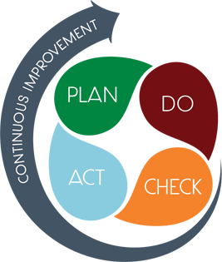
STRATEGIC PLAN SMART GOALS
Overview
  Priorities
  Key Aspects
SMART GOALS

Slide 15
Smart Goals
  By May 2023, students in grades 3-5 will increase ELA proficiency on GMAS from 14% to 19%.

Slide 16
Smart Goals
  By May 2023, students in grades 3-5 will increase Math proficiency on GMAS from 14% to 19%.

Slide 17
Smart Goals
  By May 2023, K-5 attendance rate will improve from 89% to 95%.

Slide 18
GEORGIA MILESTONES ASSESSMENT RESULTS

Slide 19
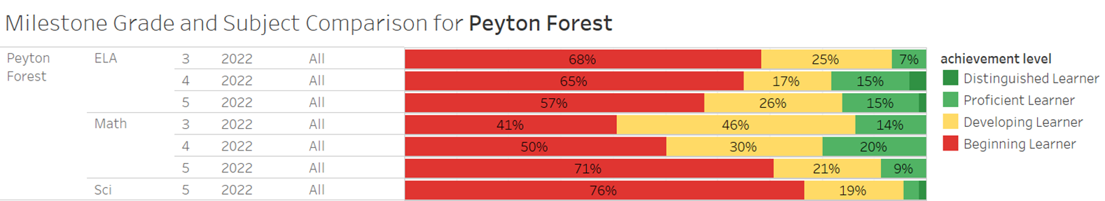
GMAS RESULTS

Slide 20
GLOWS & GROWS
GLOWS
GROWS
Care Team attendance communication (home visits, phone calls, attendance alerts, robo calls)​
ELA MAP growth proficiency increased in ELA from fall (13.4to spring from 13.4% to 16.9%​
MAP growth proficiency increased in Math from fall to spring 2.4% to 3.6%​
Weekly planning and Data Meeting Professional Learning Communities (PLC)​
K-5 daily intervention and enrichment​
Decrease in student attendance from 95.4% in 2019 to 89.6% ​ ​
Milestones ELA proficiency deceased from 24.1% to 14%​
Milestones Math proficiency decreased from 29.8% to 14%​ ​
Milestones Science proficiency decreased from 17.9% to 4.4%​ ​

Slide 21
QUESTIONS?

Slide 22
GO Team Discussion
Where we are – Where we’re going

Slide 23


Where We Are
Our strategic plan is the guide for the work we’re doing in the school. By monitoring the plan and ranking priorities, we can all work towards the common goals. Using the priorities in the strategic plan, the school leadership team developed a Continuous Improvement Plan (CIP) for the current school year.

Slide 24
Timeline for GO Teams
You are HERE
1
2
3
4
5
Fall 2021
GO Team Developed 2021-2025 Strategic Plan
Summer 2022
School Leadership completed Needs Assessment and defined overarching needs for SY22-23
August 2022
School Leadership completed 2022-2023 Continuous Improvement Plan
Sept. – Dec. 2022
Utilizing current data, the GO Team will review & possibly update the school strategic priorities and plan
Before Winter Break
GO Team will take action (vote) on the rank of the strategic plan priorities for SY23-24 in preparation for budget discussions.

Slide 25
Discussion Items
Continuous Improvement Plan
Needs Assessment
SMART GOALS
Monitoring Measures
MAP Data
Data Protocol

Slide 26
Continuous Improvement Plan
SY 2022-2023

Slide 27
School Name
Needs Assessment
Strengths | Opportunities/Challenges
Care Team attendance communication (home visits, phone calls, attendance alerts, robocalls) | Decrease in student attendance from 95.4% in 2019 to 89.6%
ELA MAP growth proficiency increased in ELA from fall (13.4to spring from 13.4% to 16.9% | Milestones ELA proficiency deceased from 24.1% to 13.8%
MAP growth proficiency increased in Math from fall to spring 2.4% to 3.6% | Milestones Math proficiency decreased from 29.8% to 13.9%
Weekly planning and Data Meeting Professional Learning Communities (PLC) | Milestones Science proficiency decreased from 17.9% to 4.4%
K-5 daily intervention and enrichment
Our Overarching Needs
Literacy: | Numeracy: | Whole Child & Student Support
Jamboard Link Here
Literacy Problem Statement | Numeracy Problem Statement | Whole Child & Student Support Problem Statement
To provide reading skills and strategies for proficiency and continual growth from reading to comprehension. | To provide strategies for proficiency and continual growth for numeracy. | Our chronic absenteeism rate stands at 52.7%.
Notes:
Notes for School CIP Teams: After completing your Comprehensive Needs Assessment ( data protocol), you will come here and identify some strengths and opportunities/challenges you have observed from the data. The priority areas are Literacy, Numeracy, and Whole Child & Student Support. Identify an overarching need for each area. Formulate a problem statement for each area. Make sure the problem statement meets the criteria. Refer to your CIP resources.

Slide 28
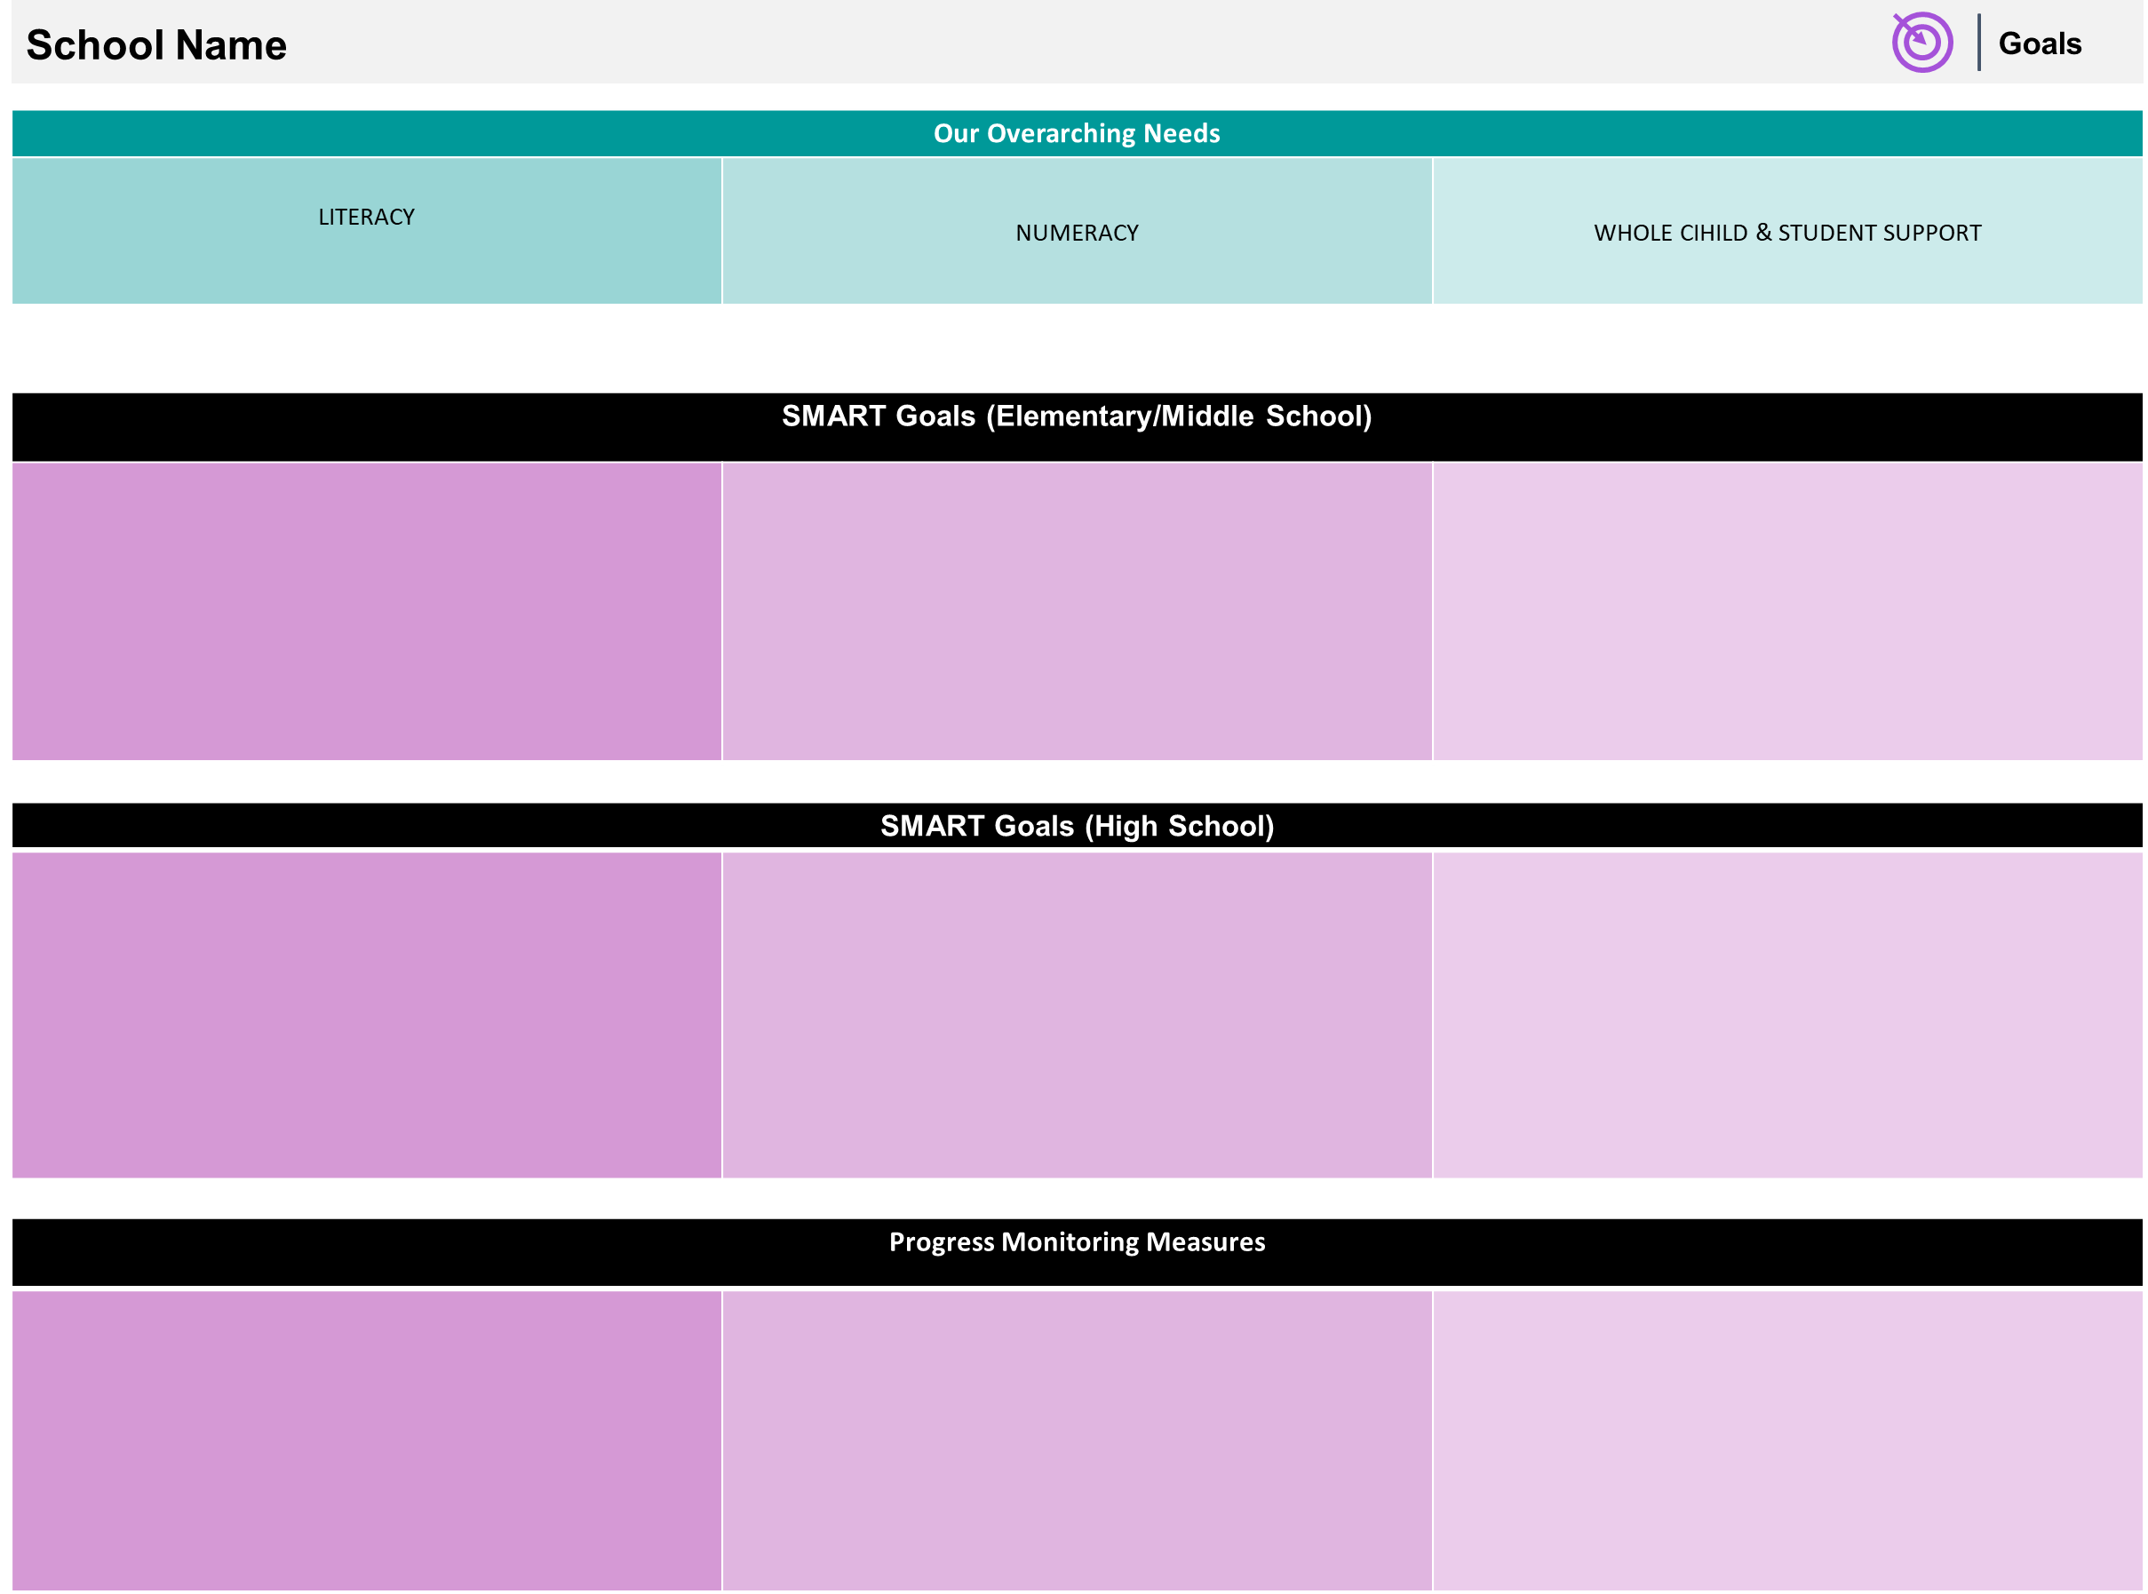
By May 2023, students in grades 3-5 will increase ELA proficiency on GMAS from 14% to 19%.
By May 2023, students in grades 3-5 will increase Math proficiency on GMAS from 14% to 19%.
By May 2023, K-5 attendance rate will improve from 89% to 95%.
N/A
MAP assessment given three times during the school year • Monthly MAP growth assessments • HMH growth assessments • Common assessments with data meetings at the conclusion of units
MAP assessment given three times during the school year • Monthly MAP growth assessments • HMH growth assessments • Common assessments with data meetings at the conclusion of units
Weekly meetings with attendance team to monitor trends • Weekly Report drill down • Social worker referrals for chronic absenteeism

Slide 29
Our Current
Progress Monitoring Measures
Literacy
Numeracy
Whole Child
MAP Data
MAP Screener
FUNdations unit tracker
MAP Data
Do the Math Assessment
Fact Fluency
Attendance
Suspension Data

Slide 30
MAP Data
1st Administration

Slide 31
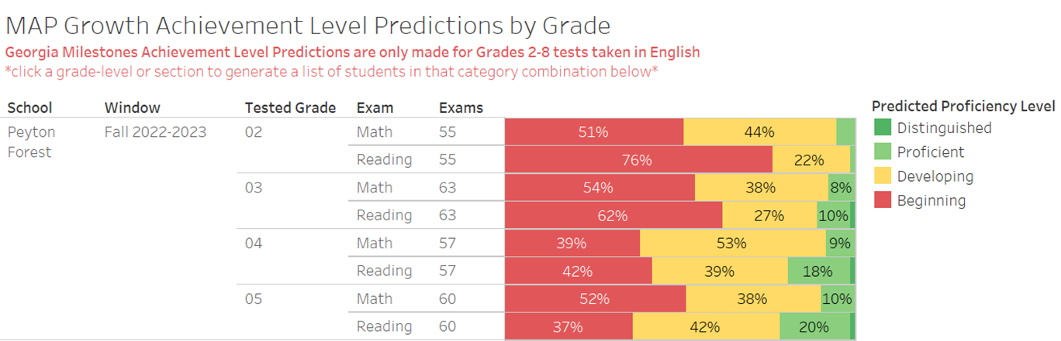
Data

Slide 32

GO Team Discussion:
Data Protocol
What do you notice?
What are your wonderings?
What additional questions do you have?

Slide 33

Strategic planning will help you fully uncover your available options, set priorities for them, and define the methods to achieve them.
Robert J. Mckain

Slide 34


Where we’re going
At our next meeting(s) we will discuss how our data is aligning to our strategic plan and determine if we need to make any adjustments.
Before we leave for Winter Break, we will take Action (vote) on ranking our strategic priorities for the 2023-2024 school year.
Let me or the Chair know of any additional information you need for our future discussion.

Slide 35
Thank you

